Slide 1
CSE 3002- programming in java unit Iv Exceptions and Assertions
Dr. R. Manikandan
Assistant professor (senior grade)
Vit bhopal university

Slide 2
Exception Handling: Introduction
An exception (or exceptional event) is a problem that arises during the execution of a program.
When an Exception occurs the normal flow of the program is disrupted and the program/Application terminates abnormally, which is not recommended, therefore, these exceptions are to be handled.
The core advantage of exception handling is to maintain the normal flow of the application. An exception normally disrupts the normal flow of the application that is why we use exception handling.

Slide 3
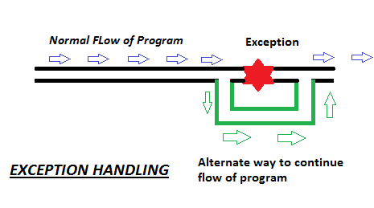
Exception Handling: Introduction

Slide 4
Exception Handling: Introduction
An exception can occur for many different reasons. Following are some scenarios where an exception occurs.
Array out of bounds
Divide by zero error
Stack overflow error
A user has entered an invalid data.
A file that needs to be opened cannot be found.
A network connection has been lost in the middle of communications or the JVM has run out of memory.
Etc.,

Slide 5
Exception Handling: Introduction
Coding mistake:
01 int[] intArray = new int[5];
02 intArray[5] = 27;
Output:
Exception in thread "main" java.lang.ArrayIndexOutOfBoundsException: 5
at TestErrors.main(TestErrors.java:17)
Notes:
This code shows a common mistake made when accessing an array. Remember that arrays are zero based (the first element is accessed by a zero index), so in an array like the one in the slide that has five elements, the last element is actually intArray[4].
intArray[5] tries to access an element that does not exist, and Java responds to this programming mistake by throwing an ArrayIndexOutOfBounds exception. The information stored within the exception is printed to the console.

Slide 6
Exception Handling: Introduction
Calling code in main:
19 TestArray myTestArray = new TestArray(5);
20 myTestArray.addElement(5, 23);
TestArray class:
13 public class TestArray {
14 int[] intArray;
15 public TestArray (int size) {
16 intArray = new int[size];
17 }
18 public void addElement(int index, int value) {
19 intArray[index] = value; }
20 }
Stack trace:
Exception in thread "main" java.lang.ArrayIndexOutOfBoundsException: 5
at TestArray.addElement(TestArray.java:19)
at TestException.main(TestException.java:20)
Java Result: 1
Notes:
Here is a very similar example, except that this time the code that creates the array and tries to assign a value to a nonexistent element has been moved to a different class (TestArray). Notice how the error message, shown below, is almost identical to the previous example, but this time the methods main in TestException, and addElement in TestArray are explicitly mentioned in the error message. (In NetBeans the message is in red as it is sent to System.err).
Exception in thread "main" java.lang.ArrayIndexOutOfBoundsException: 5
at TestArray.addElement(TestArray.java:19)
at TestException.main(TestException.java:20)
Java Result: 1
This is called “the stack trace.” It is an unwinding of the sequence of method calls, beginning with where the exception occurred and going backwards.
In this lesson, you learn why that message is printed to the console. You also learn how you can catch or trap the message so that it is not printed to the console, and what other kinds of errors are reported by Java.

Slide 7
Exception: Types
Some of these exceptions are caused by user error, others by programmer error, and others by physical resources that have failed in some manner. Based on these, we have three categories of Exceptions.
Checked exceptions − A checked exception is an exception that occurs at the compile time, these are also called as compile time exceptions. These exceptions cannot simply be ignored at the time of compilation, the programmer should take care of (handle) these exceptions.
Example: IOException, ClassNot Found Exception, SQLException, SocketException, etc.,

Slide 8
Exception: Types
Unchecked exceptions − An unchecked exception is an exception that occurs at the time of execution. These are also called as Runtime Exceptions.
These include programming bugs, such as logic errors or improper use of an API. Runtime exceptions are ignored at the time of compilation.
Example: ArithmeticException, NullPointerException, ArrayIndexOutOfBoundsException etc.
Errors - Errors are abnormal conditions that happen in case of severe failures, these are not handled by the Java programs. Errors are generated to indicate errors generated by the runtime environment.
Example: OutOfMemoryError, VirtualMachineError, StackOverflowError, etc.

Slide 9
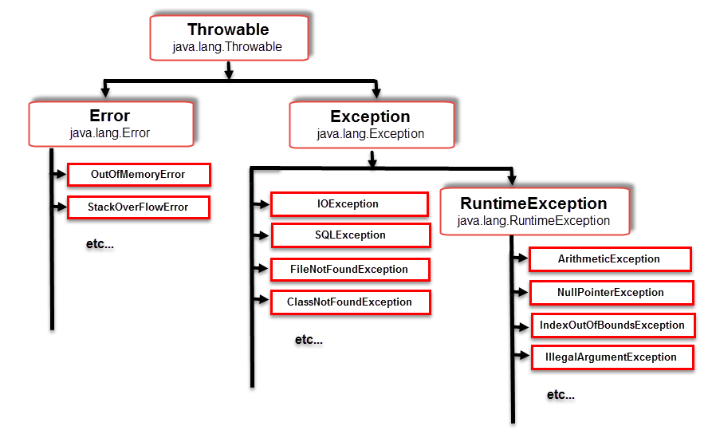
Hierarchy of Java Exception classes
Exceptions are subclasses of Throwable. There are three main types of Throwable: Error, Exception and RuntimeException

Slide 10
Hierarchy of Java Exception classes
Exceptions are subclasses of Throwable. There are three
main types of Throwable:
Error
Typically an unrecoverable external error
Unchecked Exception
RuntimeException
Typically caused by a programming mistake
Unchecked Exception
Exception
Recoverable error
Checked Exception (Must be caught or thrown)
In Java exceptions under Error and RuntimeException classes are unchecked exceptions, everything else under throwable is checked.

Slide 11
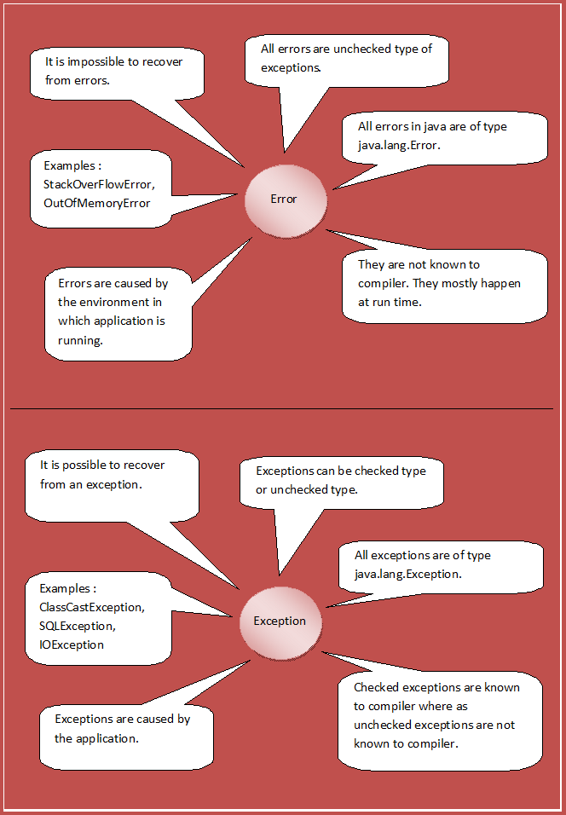
Error Vs. Exception

Slide 12
Exception: Keywords
Keyword | Description
try | The "try" keyword is used to specify a block where we should place exception code. The try block must be followed by either catch or finally. It means, we can't use try block alone.
catch | The "catch" block is used to handle the exception. It must be preceded by try block which means we can't use catch block alone. It can be followed by finally block later.
finally | The "finally" block is used to execute the important code of the program. It is executed whether an exception is handled or not.
throw | The "throw" keyword is used to throw an exception.
throws | The "throws" keyword is used to declare exceptions. It doesn't throw an exception. It specifies that there may occur an exception in the method. It is always used with method signature.

Slide 13
Without Exception Handling
Example:
public class Testtrycatch1{
public static void main(String args[]){
int data=50/0;//may throw exception
System.out.println("rest of the code...");
}
}
Output: Exception in thread main java.lang.ArithmeticException:/ by zero
As displayed in the above example, rest of the code is not executed (in such case, rest of the code... statement is not printed).
There can be 100 lines of code after exception. So all the code after exception will not be executed.

Slide 14
Exception Handling
The Exception handling mechanism suggests incorporation of a separate error handling code that performs the following tasks:
Find the problem (Hit the exception)
Inform that an error has occurred (Throw the exception)
Receive the error information ( Catch the exception)
Take corrective actions (Handle the exception)

Slide 15
Catching Exceptions
A method catches an exception using a combination of the try and catch keywords. A try/catch block is placed around the code that might generate an exception. Code within a try/catch block is referred to as protected code.
Java try block is used to enclose the code that might throw an exception. It must be used within the method. Java try block must be followed by either catch or finally block.
Syntax:
try {
// Protected code
} catch (ExceptionName e1) {
// Catch block
}

Slide 16
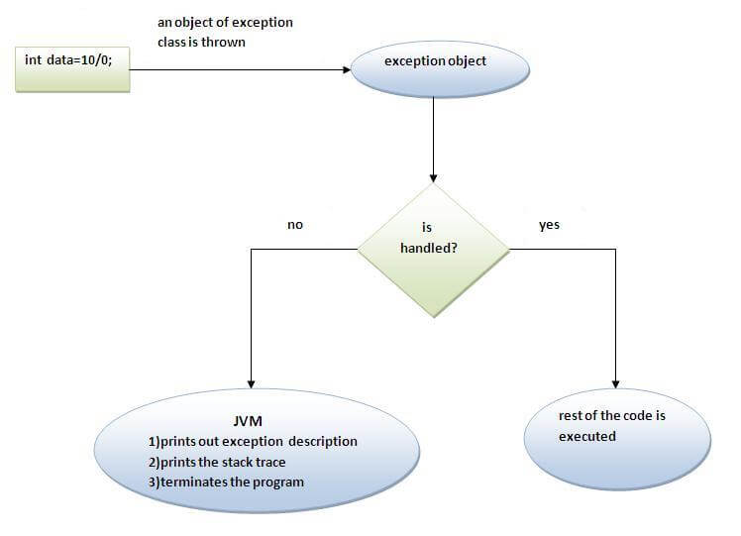
Internal working of java try-catch block

Slide 17
Catching Exceptions: Example
public class Exception1{
public static void main(String args[]){
try{
//code that may raise exception
int data=100/0;
}catch(ArithmeticException e){System.out.println(e);}
//rest code of the program
System.out.println("rest of the code...");
}
}
Example: Exception1.java

Slide 18
Catching Exceptions: Example
public class Exception2{
public static void main(String args[]) {
try {
int a[] = new int[2];
System.out.println("Access element three :" + a[3]);
} catch (ArrayIndexOutOfBoundsException e) {
System.out.println("Exception thrown :" + e);
}
System.out.println("Out of the block");
}
}
Example: Exception2.java

Slide 19
3 Different ways to print Exception messages in Java
java.lang.Throwable.printStackTrace() method
By using this method, we will get name(e.g. java.lang.ArithmeticException) and description(e.g. / by zero) of an exception separated by colon, and stack trace (where in the code, that exception has occurred) in the next line.
e.printStackTrace();
toString() method
By using this method, we will only get name and description of an exception
System.out.println(e.toString()); (or) System.out.println(e);
java.lang.Throwable.getMessage() method
By using this method, we will only get description of an exception.
System.out.println(e.getMessage());

Slide 20
Multi catch block
If you have to perform different tasks at the occurrence of different Exceptions, use java multi catch block.
When an exception in a try block is generated, the java treats the multiple catch statements like cases in a switch statement.
The first statement whose parameter matches with the exception object will be executed, and the remaining statements will be skipped.
Note:
At a time only one Exception is occurred and at a time only one catch block is executed.
All catch blocks must be ordered from most specific to most general i.e. catch for ArithmeticException must come before catch for Exception .
Example: Exception3.java, Exception4.java

Slide 21
Java throw keyword
The throw keyword in Java is used to explicitly throw an exception from a method or any block of code.
We can throw either checked or uncheked exception in java by throw keyword.
The throw keyword is mainly used to throw custom exception.
Syntax: throw exception; (or)
throw new IOException("sorry device error”);
Example: Exception5.java, Exception6.java

Slide 22
Java throws keyword
throws is a keyword in Java which is used in the signature of method to indicate that this method might throw one of the listed type exceptions.
The caller to these methods has to handle the exception using a try-catch block.
It provides information to the caller of the method about the exception.
To handle the exception when you call this method, all the exceptions that are declared using throws, must be handled where you are calling this method else you will get compilation error.
Syntax:
type method_name(parameters) throws exception_list
Example: Exception7.java, Exception8.java, Exception8_1.java

Slide 23
Java finally block
Java finally block is a block that is used to execute important code such as closing connection, stream etc.
Java finally block is always executed whether exception is handled or not.
Java finally block follows try or catch block.
Note: If you don't handle exception, before terminating the program, JVM executes finally block(if any).
Example: Exception9.java, Exception10.java, Exception11.java

Slide 24
Java Custom Exception
If you are creating your own Exception that is known as custom exception or user-defined exception. Java custom exceptions are used to customize the exception according to the user application needs.
By the help of custom exception, you can have your own exception and message.
Notes: 1. User-defined exception must extend Exception class. 2. The exception is thrown using throw keyword.
Example: Exception12.java, Exception13.java

Slide 25
Assertions in Java
An assertion allows testing the correctness of any assumptions that have been made in the program.
An assert statement is used to declare an expected boolean condition in a program. If the program is running with assertions enabled, then the condition is checked at runtime. If the condition is false, the Java runtime system throws an AssertionError.
It is mainly used for testing purposes during development.
Syntax:
assert expression; (or)
assert expression1 : expression2;

Slide 26
Assertions in Java
By default, assertions are disabled. We need to run the code as given.
Enabling Assertions
java –ea Test (or)
java –enableassertions Test
Here, Test is the file name.
Disabling Assertions
java –da Test (or)
java –disableassertions Test
Here, Test is the file name.
Example: Assertion1.java, Assertion2.java

Slide 27
Assertions in Java
Where to use Assertions
Arguments to private methods.
Use assertion in the default case of the Switch statement
Conditional cases.
Conditions at the beginning of any method.
Where not to use Assertions
Assertions should not be used to replace error messages
Assertions should not be used to check arguments in the public methods as they may be provided by user.
Avoid catching assertion related exception
Assertions should not be used on command line arguments.
Avoid the use of evaluating more than one condition in an assertion

